Slide 1
Software Measures

Slide 2
The Importance of Integrity in Measurement
A measurement procedure must demonstrate a number of characteristics. It must be
Empirical: The result of measurement should describe empirically established facts.
Objective: During measurement, observations should be carried out with integrity, objectively, reliably, efficiently and without bias or ambiguity. If this is done, it should always be possible for someone else to repeat the measurement.
Encodable: An attribute can be encoded or characterized using different symbols such as numbers and graphic representations. The assignment of numbers in this fashion is aimed at preserving observed relations between entities. For example, the description of the length of programs using lines of code preserves the observed relation 'longer than'.

Slide 3
Software Measurement
In general, there are three software maintenance-related entities whose attributes can be subjected to measurement: process, product and resource:
A process is any software-related activity such as change analysis, specification, design, coding and testing.
A resource is input to a process, for example personnel, hardware and software.
A product is any intermediate or final output resulting from a software process such as system documentation (for example, specification and design), program listings, test data, source code and object code.

Slide 4
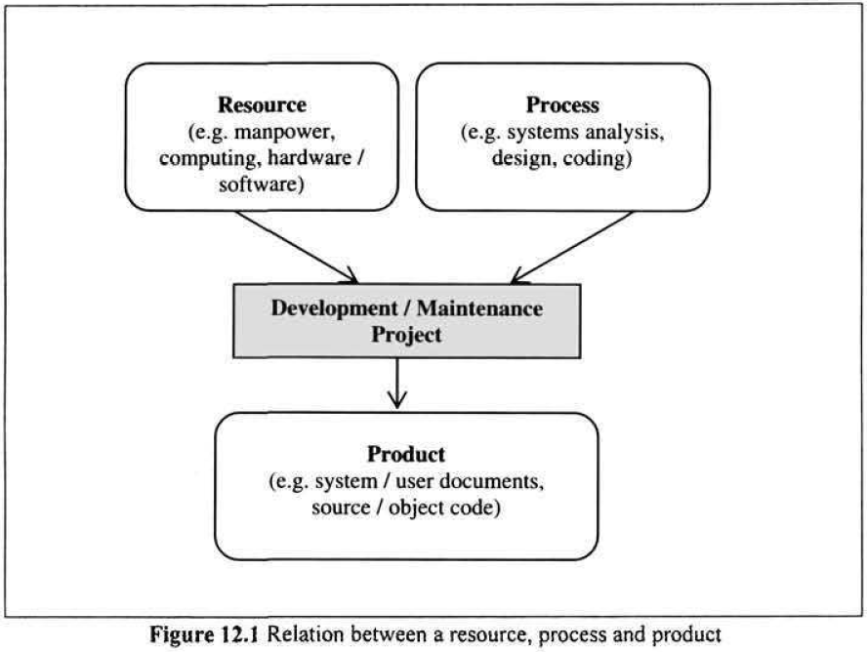
Resource, Process and Product

Slide 5
Attribute
An internal attribute is one which can be measured in terms of the process, product or resource itself. For example, complexity, modularity and reusability are internal attributes of the source code of a program.
An external attribute is one which can only be measured with respect to the relation of a process, product or resource to its environment, for example the maintainability of program source code or productivity of software personnel.

Slide 6
Software Measure and Software Metric
The result of a software measurement process is known as a software measure.
An entity can have more than one measure for the same attribute; that is, more than one mapping.
The terms measure and metric are still being used interchangeably in the literature.

Slide 7
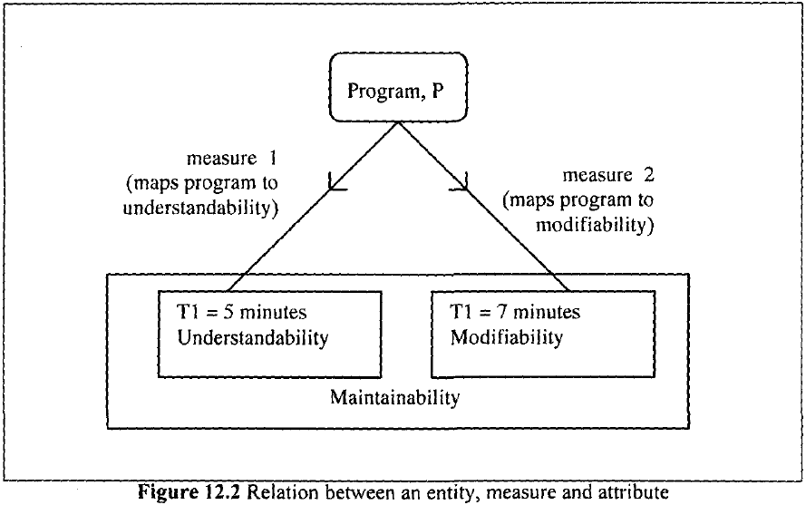
Example

Slide 8
Objectives of Software Measurement
Evaluation
There is a need for maintainers to valuate different methods, program libraries and tools before arriving at a decision as to which is best suited to a given task.
Control
There is a need to control the process of software change to ensure that change requests are dealt with promptly and within budget.
Assessment
In order to control a process or product, it is important to be able to assess or to characterize it first. For instance, a manager may need to assess a system to determine whether or not it is economically feasible to continue maintaining it.
Improvement
There is a need to improve various characteristics of the software system or process such as quality and productivity. It is difficult to assess and monitor such improvements without an objective means of measuring the characteristics.
Prediction
There is a need to make predictions about various aspects of the software product, process and cost. For instance, measures obtained from program code can be used to predict the time required to implement a given change.

Slide 9
Examples of Software Metrics
Size
One of the commonest ways of measuring the size of a program is by counting the number of lines of code.
Usually expressed in thousands of lines of code (KLOC).
During maintenance, the focus is on the 'delta' lines of code: the number of lines of code that have been added or modified during a maintenance process.
Easy to determine and also correlates strongly with other measures such as effort and error density.
No standards for LOC measurement and it is dependent on the programming language in question.
Too simple and does not reflect cost or productivity.

Slide 10
Examples of Software Metrics
Complexity
There is no consensus on a definition for the term 'complexity'. This is evident in the wide variety of complexity measures reported in the literature. In software maintenance, however, it is useful to define program complexity.
One of the major problems that software maintainers face is dealing with the increasing complexity of the source code that they have to modify.
Includes program structure, semantic content, control flow, data flow and algorithmic complexity.
The more complex a program is, the more likely it is for the maintainer to make an error when implementing a change.
The higher the complexity value, the more difficult it is to understand the program, hence making it less maintainable.

Slide 11
McCabe's Cyclomatic Complexity
McCabe's Cyclomatic Complexity
McCabe views a program as a directed graph in which lines of program statements are represented by nodes and the flow of control between the statements is represented by the edges. McCabe's cyclomatic complexity (also known as the cyclomatic number) is the number of 'linearly independent' paths through the program (or flow graph) and this value is computed using the formula:
v(F) =e-n+2
where n = total number of nodes; e = total number of edges or arcs; and v(F) is the cyclomatic number.

Slide 12
McCabe's Cyclomatic Complexity
Used as an indicator of the psychological complexity of a program.
During maintenance, a program with a very high cyclomatic number (usually above 10) is considered to be very complex.
It helps to identify highly complex programs that may need to be modified in order to reduce complexity.
The cyclomatic number can be used as an estimate of the amount of time required to understand and modify a program.
The flow graph generated can be used to identify the possible test paths during testing.

Slide 13
McCabe's Cyclomatic Complexity
It takes no account of the complexity of the conditions in a program
In its original form, it failed to take account of the degree of nesting in a program.

Slide 14
Object Oriented Software Metric
Weighted Methods per Class (WMC)
Depth of Inheritance Tree (DIT)
Number of Children (NOC)
Coupling between Classes (CBC)
Lack of Cohesion in Methods (LCOM)

Slide 15
Weighted Methods per Class (WMC)
The effort in developing a class will in some sense will be determined by the number of methods the class has and the complexity of the methods.
Suppose a class C has methods M1, M2... Mn defined on it. Let the complexity of the method M1 be c1, then
WMC =
If the complexity of each method is considered 1, WMC gives the total number of methods in the class.
The data based on evaluation of some existing programs, shows that in most cases, the classes tend to have only a small number of methods, implying that most classes are simple and provide some specific abstraction and operations.
WMC metric has a reasonable correlation with fault-proneness of a class. As can be expected, the larger the WMC of a class the better the chances that the class is fault-prone.

Slide 16
Depth of Inheritance Tree (DIT)
Inheritance is one of the unique features of the object- oriented paradigm.
Inheritance is one of the main mechanisms for reuse
The deeper a particular class is in a class hierarchy, the more methods it has available for reuse, thereby providing a larger reuse potential
Inheritance increases coupling, which makes changing a class harder
A class deep in the hierarchy has a lot of methods it can inherit, which makes it difficult to predict its behavior
The DIT of a class C in an inheritance hierarchy is the depth from the root class in the inheritance tree
It is the length of the shortest path from the root of the tree to the node representing C or the number of ancestors C has
In case of multiple inheritance, the DIT metric is the maximum length from a root to C
Statistical data suggests that most classes in applications tend to be close to the root, with the maximum DIT metric value being around 10
Most the classes have a DIT of 0 (that is, they are the root).
The designers tend to keep the number of abstraction levels (reflected by the levels in the inheritance tree) small, presumably to aid understanding. In other words, designers might be giving upon reusability in favor of comprehensibility
The experiments show that DIT is very significant in predicting defect-proneness of a class: the higher the DIT the higher is the probability that the class is defect-prone

Slide 17
Number of Children (NOC)
The number of children (NOC) metric value of a class C is the number of immediate subclasses of C
This metric can be used to evaluate the degree of reuse, as a higher NOC number reflects reuse of the definitions in the superclass by a larger number of subclasses
It also gives an idea of the direct influence of a class on other elements of a design
The larger the influence of a class, the more important the class is correctly designed
In the empirical observations, it was found that classes generally had a small NOC metric value, with a vast majority of classes having no children
This suggests that in the systems analyzed, inheritance was not used very heavily
The data suggest that the larger the NOC, the lower the probability of detecting defects in a class
The higher NOC classes are less defect-prone. The reasons for this are not very clear or definite.

Slide 18
Coupling between Classes (CBC)
Coupling between classes of a system reduces modularity and make class modification harder
It is desirable to reduce the coupling between classes
The less coupling of a class with other classes, the more independent the class, and more easily modifiable
Coupling between classes (CBC) is a metric that tries to quantify coupling that exists between classes
The CBC value for a class C is the total number of other classes to which the class is coupled
Two classes are considered coupled if methods of one class use methods or instance variables defined in the other class
There are indirect forms of coupling (through pointers, etc.) that are hard to identify
The experimental data indicates that most of the classes are self-contained and have low CBC value.
Some types of classes, for example the ones that deal with managing interfaces, generally tend to have higher CBC values
The data found that CBC is significant in predicting the fault-proneness of classes, particularly those that deal with user interfaces.

Slide 19
Lack of Cohesion in Methods (LCOM)
Cohesion captures how closely bound the different methods of the class are
Two methods of a class C can be considered “cohesive” if the set of instance variables of C that they access have some elements in common
High cohesion is a highly desirable property for modularity
Let I_{i} and I_{j} be the set of instance variables accessed by the methods M₁ and M₂, Q be the set of all cohesive pairs of methods, that is, all (M_{i}, M_{j}) such that I_{i} and I_{j} have a non-null intersection. Let P be the set of all noncohesive pairs of methods, that is, pairs such that the intersection of sets of instance variables they access is null. Then LCOM is defined as
LCOM = |P|-|Q|, if |P| > |Q|, otherwise 0.
If there are n methods in a class C, then there are n(n — 1) pairs, and LCOM is the number of pairs that are noncohesive minus the number of pairs that are cohesive
The larger the number of cohesive methods, the more cohesive the class will be, and the LCOM metric will be lower
A high LCOM value may indicate that the methods are trying to do different things and operate on different data entities
If this is validated, the class can be partitioned into different classes
The data in [BBM95] found little significance of this metric in predicting the fault-proneness of a class

Slide 20
Quality
Fitness for purpose
A quality product, be it a word processor or a flight control system, is one which does what the user expects it to do.

Slide 21
Product Quality
Dividing the number of unique change requests made by customers for the first year of field use of a given release, by the number of thousand lines of code for that release.
This measure only includes requests which pertain to faults detected by customers.
The measure excludes feature enhancement change requests which are not contained in the software requirements specification.
The other measure of product quality is the number of faults that are detected after the software system becomes operational, usually after the first year of shipment.
The number of users reporting the same fault may be used as a measure of the significance of the fault and therefore the priority that should be attached to fixing it.

Slide 22
Process Quality
Two measures of process quality are schedule and productivity.
The difference between the planned and actual work time to achieve the milestone of first customer delivery, divided by the planned work time.
A negative number signifies a slip and a positive number signifies early delivery.

Slide 23
Process Quality
The productivity is computed by dividing the number of lines of code that have been added or modified by the effort in staff days required to make the addition or modification.
Effort is the total time from analyzing the change requests to a successful implementation of the change.

Slide 24
Understandability
The ability to determine what a program does and how it works by reading its source code and accompanying documentation.
Understandability usually has an inverse relation to complexity; as the complexity of a program increases, the understandability tends to decrease.

Slide 25
Maintainability
The ease with which the software can be understood, corrected, adapted, and/or enhanced.
Mean Time To Repair (MTTR): the mean time required to effect a change.
Depending on the circumstances, the calculation of MTTR may require information on the problem recognition time, administrative delay time, maintenance tools collection time, problem analysis time, change specification time and change time.

Slide 26
Cost Estimation
The cost of a maintenance project is the resources - personnel, machines, time and money - expended on effecting change.
Boehm's COCOMO model
According to Boehm, the cost of maintenance is affected by attributes of factors called cost drivers. Examples of cost drivers are database size, program complexity, use of modern programming practices and applications experience of the maintenance personnel.

Slide 27
Guidelines for Selecting Maintenance Measures
Clearly defined objectives
These objectives will determine the measures to be used and the data to be collected.
Personnel involvement
The purpose of measurement in an organization needs to be made clear to those involved in the program.
Ease of use
The measures that are finally selected to be used need to be easy to use, take not too much time to administer, be unobtrusive, and possibly subject to automation.

